Slide 1
Unit-III

Slide 2
Greedy Method
Greedy algorithm obtains an optimal solution by making a sequence of decisions.
Decisions are made one by one in some order.
Each decision is made using a greedy-choice property or greedy criterion.
A decision, once made, is (usually) not changed later.

Slide 3
It gives an optimal solution when applied to problems with the greedy-choice property.
A feasible solution is a solution that satisfies the constraints.
An optimal solution is a feasible solution that optimizes the objective function.

Slide 4
Greedy method control abstraction/ general method
Algorithm Greedy(a,n)
// a[1:n] contains the n inputs
{
solution=0 ; //Initialize solution
for i=1 to n do
{
x:=Select(a);
if Feasible(solution , x) then
solution=Union(solution , x)
else
reject();
}
return solution;
}

Slide 5
Fractional Knapsack Problem
Given: A set S of n items, with each item i having
  p_{i} - a positive profit
  w_{i} - a positive weight
Goal: Choose items, allowing fractional amounts(x_{i}), to maximize total profit but with weight at most m.
maximize ∑ p_{i}x _{i}
1 ≤ i ≤ n
subjected to ∑ w_{i}x_{i} ≤ m
1 ≤ i ≤ n
and 0 ≤ x_{i} ≤ 1, 1 ≤ i ≤ n

Slide 6

Fractional Knapsack Problem
Greedy decision property:-
Select items in decreasing order of profit/weight.
“knapsack”
Solution:
1 ml of i₅
2 ml of i₃
6 ml of i₄
1 ml of i₂
Items:
1
2
3
4
5
w_{i} :
4 ml
8 ml
2 ml
6 ml
1 ml
p_{i} :
$12
$32
$40
$30
$50
10 ml
Value:
3
4
20
5
50
($ per ml)

Slide 7
Solution vector
  (x₁,x₂,x₃,x₄,x₅)= (0,1/8,1,1,1)
Profit =12*0 + 32*1/8 + 40*1 + 30*1 + 50*1
= 0+4+40+30+50
=124.

Slide 8
Greedy algorithm for the fractional Knapsack problem
Algorithm GreedyKnapsack(m,n)
//P[1:n] and w[1:n] contain the profits and weights
// respectively of the n objects ordered such that
//p[i]/w[i]>=p[i+1]/w[i+1].
//m is the knapsack size and x[1:n] is the solution Vector.
{
for i=1 to n do x[i]=0; // Initialize x.
U=m;
for i=1 to n do
{
if ( w[i]>U ) then break;
if x[i]=1; U=U-w[i];
}
if ( i <=n) then x[i]= U/w[i];
}
If you do not consider the time to sort the items, then the time taken by the
above algorithm is O(n).

Slide 9
0/1 Knapsack Problem
An item is either included or not included into the knapsack.
Formally the problem can be stated as
maximize ∑ p_{i}x_{i}
1 ≤ i ≤ n
subjected to ∑ w_{i}x_{i} ≤ m
1 ≤ i ≤ n
and x_{i}=0 or 1, 1 ≤ i ≤ n

Slide 10














Which items should be chosen to maximize the amount of money while still keeping the overall weight under m kg ?
m
Is the fractional knapsack algorithm applicable?

Slide 11
The greedy method works for fractional knapsack problem, but it does not for 0/1 knapsack problem.
Ex:-
30
20
$80
30
item3
$120
20
20
item2
30
$100
item1
$100
20
20
10
10
$100
10
$60
$60
$60
$100
$120
=$160
=$220
=$240
Knapsack
Capacity 50 gms
(a)
(b)
(c)

Slide 12
There are 3 items, the knapsack can hold 50 gms.
The value per gram of item 1 is 6, which is greater than the value per gram of either item2 or item3.
The greedy approach ( Decreasing order of profit’s/weight’s), does not give an optimal solution.
As we can see from the above fig., the optimal solution takes item2 and item3.
For the fractional problem, the greedy approach (Decreasing order of profit’s/weight’s) gives an optimal solution as shown in fig c.

Slide 13
Spanning Tree
A tree is a connected undirected graph that contains no cycles.
A spanning tree of a graph G is a subgraph of G that is a tree and contains all the vertices of G.

Slide 14
Properties of a Spanning Tree
The spanning tree of a n-vertex undirected graph has exactly n – 1 edges.
It connects all the vertices in the graph.
A spanning tree has no cycles.

Slide 15
Ex:-
1
A
B
A
1
B
A
B
5
4
2
4
2
4
6
D
C
D
C
D
C
3
3
3
1
1
Undirected Graph
A
B
A
B
2
2
4
D
C
D
C
3
…
Some Spanning Trees

Slide 16
Minimum Cost Spanning Tree / Minimum Spanning Tree (MST)
A minimum spanning tree is the one among all the spanning trees with the smallest total cost.
1
1
A
B
A
B
4
2
2
D
C
D
C
3
3
Undirected Graph
Minimum Spanning Tree

Slide 17
Applications of MSTs
Computer Networks
  To find how to connect a set of computers using the minimum amount of wire.

Slide 18
MST-Prim’s Algorithm
Start with minimum cost edge.
Select next minimum cost edge (i,j) such that i is a vertex already included in the tree, j is a vertex not yet included.
Continue this process until the tree has n - 1 edges.

Slide 19
Prim’s Algorithm
1
1
28
10
2
2
14
10
6
16
7
14
16
6
24
3
7
25
3
5
18
25
12
22
5
4
12
22
4

Slide 20
Algorithm:
Algorithm prim(adjmatrix[1..n],[1..n])
{
//n=no. of nodes in the graph
//nEdges=current no. of edges included in the MST
//min=minimum weight(cost) of edge
//row,col indicate the row & col of the edge included in the MST
//sum=total min weight cost of the edges included in the MST
//initialize selected[ ] with zeros

Slide 21
Selected[1]=1; //to start with node 1 included in MST
nEdges=1;
sum=0;
while(nEdges<n)
min=infinity;
for i=1 to n do
{
if (selected[i]=1) //if node I is included in MST then repeat to get the min cost node j to connect to i
for j=2 to n do //select the min cost edge
{

Slide 22
If (selected[j]=0) //select the min cost edge
if (min>adjmatrix[i][j])
min=adjmatrix[i][j];
print adjmatrix[i][j]);
}
selected[j]=1; //once i & j form a min edge mark 1 as selected
nEdges++;
sum=sum+ adjmatrix[i][j];
}
print sum;
}

Slide 23
Best Case: The time complexity of Prim's Algorithm can be reduced to O(ElogV) using an adjacency list.
Worst Case: But in a complete graph, E = V * (V - 1) = (V^2).

Slide 24
Kruskal’s Method
Start with a forest that has no edges.
Add the next minimum cost edge to the forest if it will not cause a cycle.
Continue this process until the tree has n - 1 edges.

Slide 25
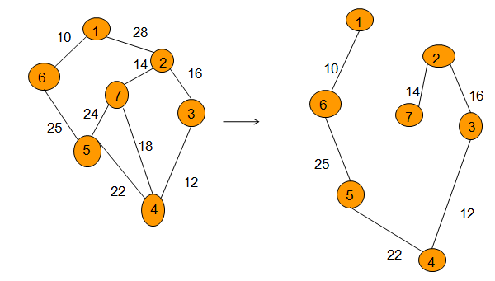
Kruskal’s Algorithm

Slide 26
Algorithm Kruskals(E,cost,n,t)
  {
  i=0;
  mincost=0;
  while(i<=n-1)
  {
  delete a min cost edge(u,v);
  j=find(u);
  k=find(v);
  if(j! = k)
  {
  i=i+1;

Slide 27
t[i:1]=u;
t[i:2]=v;
Mincost=mincost + cost(u,v);
union (j,k);
}
}
In Kruskal's algorithm, we first sort all graph edges by their weights. This operation takes O(ElogE) time, where E is the total number of edges. Then we use a loop to go through the sorted edge list. In each iteration, we check whether a cycle will be formed by adding the edge into the current spanning tree edge set.

Slide 28
Disjoint Sets
Two sets A and B are said to be disjoint if there are no common elements i.e., A ∩ B = ∅ .
Example:
1) S₁={1,7,8,9}, S₂={2,5,10}, and S₃={3,4,6}.
are three disjoint sets.

Slide 29
We identify a set by choosing a representative element of the set. It doesn’t matter which element we choose, but once chosen, it can’t be changed.
Disjoint set operations:
  FIND-SET(x): Returns the representative of the set
  containing x.
  UNION(i,j): Combines the two sets i and j into one new
  set. A new representative is selected.
  ( Here i and j are the representatives of the sets )

Slide 30
Disjoint Sets Example
Make-Set(1)
Make-Set(2)
Make-Set(3 )
Make-Set(4)
Union(1,2)
Union(3,4)
Find-Set(2)
Find-Set(4)
Union(2,4)
1
2
3
4
returns 1
returns 3

Slide 31
MST-Kruskal’s Algorithm
Algorithm kruskal(E,cost,n,t)
// E is the set of edges in G.
//cost[1:n,1:n] is the cost matrix such that cost[i,j] is either
// positive real number or ∞ if no edge (i,j) exists. cost[i,j]=0, if i=j.
// A minimum spanning tree is computed and stored
// as a set of edges in the array t[1:n-1].
{
for i:=1 to n do
Make-Set(i); // each vertex is in a different set.
Sort the edges of E into increasing order by cost.

Slide 32
mincost:=0; i:=1;
for each edge (u,v) € E, taken in increasing order by cost do
{ j:= Find-Set(u); k:= Find-Set(v)
if( j≠k ) then
{
t[i,1]:=u; t[i,2]:=v;
mincost:=mincost+cost[u,v];
Union(j,k);
i:=i+1;
}
return mincost;
}

Slide 33
Time complexity of kruskal’s algorithm
With an efficient Find-set and union algorithms, the running time of kruskal’s algorithm will be dominated by the time needed for sorting the edge costs of a given graph.
Hence, with an efficient sorting algorithm( merge sort ), the complexity of kruskal’s algorithm is
o( ElogE).

Slide 34
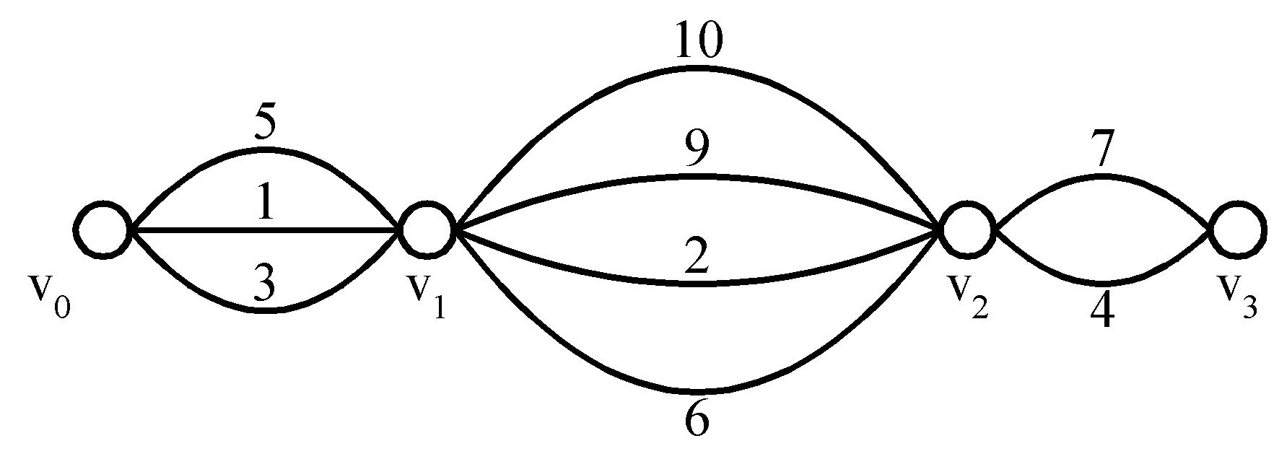
Example:
Shortest Path on a Special Graph
Problem
  Find a shortest path from v₀ to v₃
Greedy Solution

Slide 35
Example:
Shortest Paths on a Special Graph
Problem
  Find a shortest path from v₀ to v₃
Greedy Solution Is the solution optimal?

Slide 36
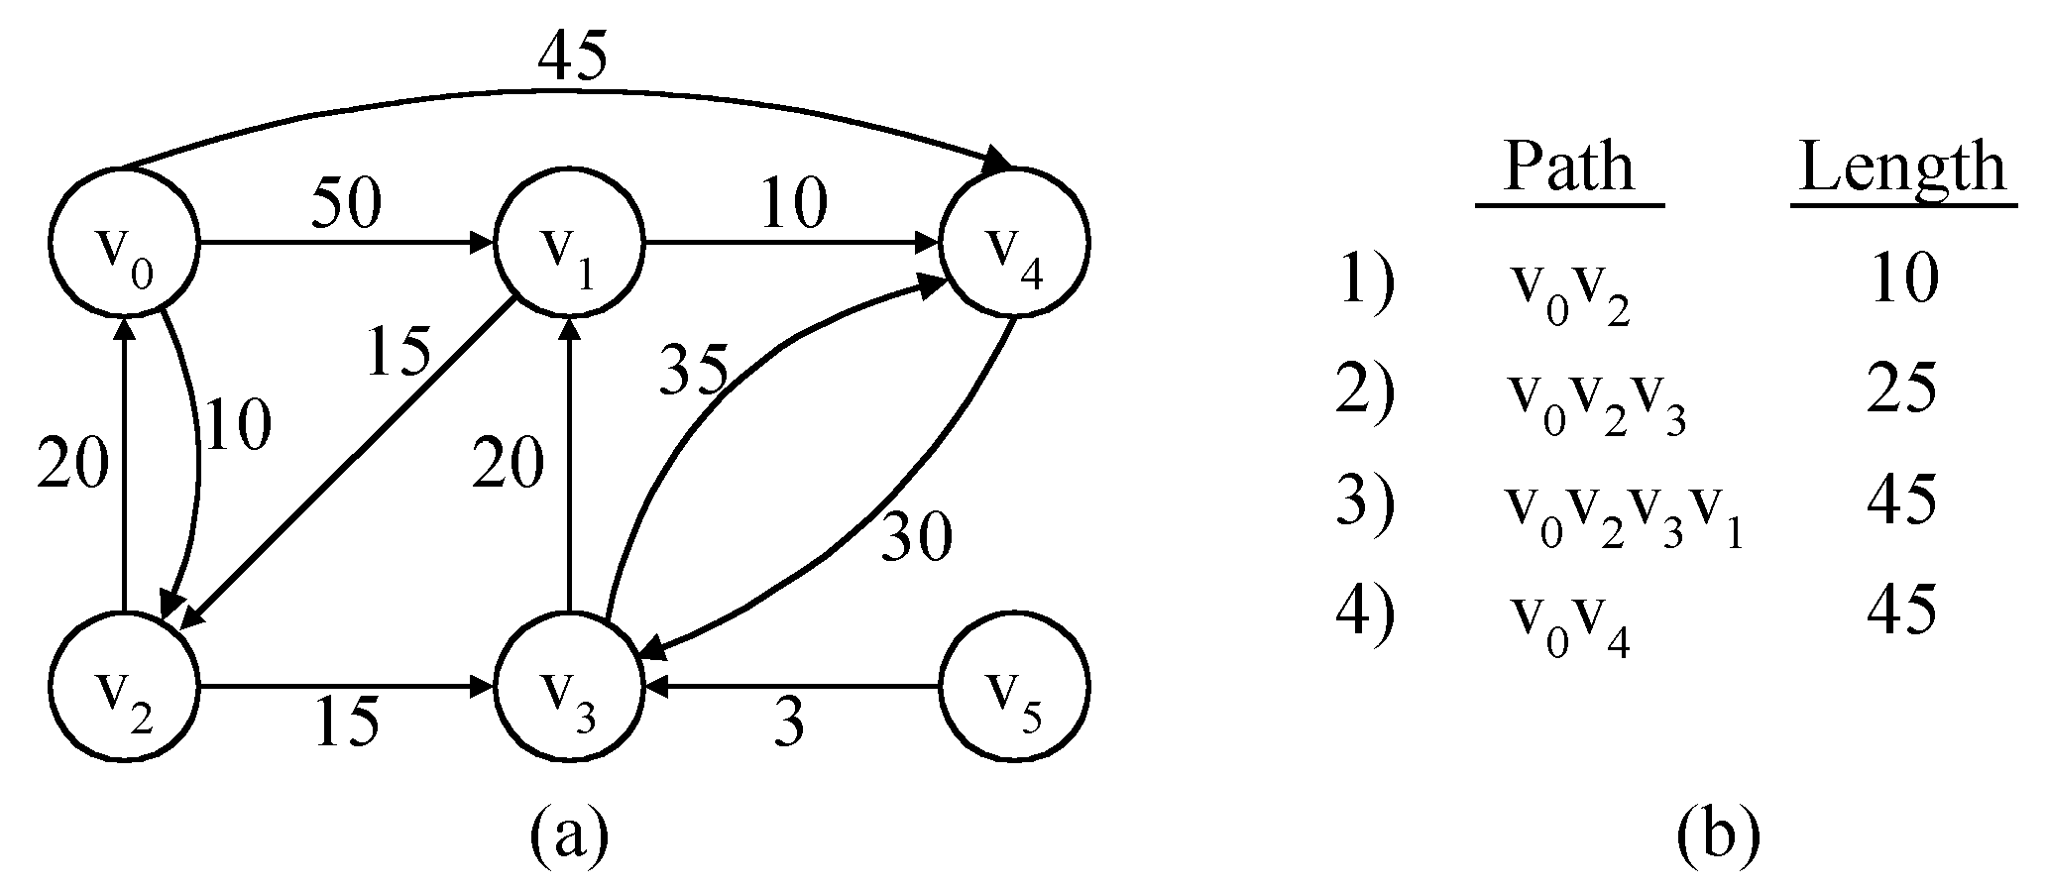
The Single-Source Shortest path Problem ( SSSP)
Given a positively weighted directed graph G with a source vertex v, find the shortest paths from v to all other vertices in the graph.
Ex :-
v
V₁
V₂
V₅
V₁V₃
V₁V₃V₄
V₁V₃V₄V₂
V₃
V₄
V₆
V₁V₅
5) V₁V₃V₄V₆ 28

Slide 37
45
45
50
2
10
5
50
2
✓
10
5
1
1
15
✓
15
35
35
10
20
20
30
20
10
20
30
3
15
4
3
6
3
15
4
3
6
✓
✓
✓
Iteration | S | Dist[2] | Dist[3] | Dist[4] | Dist[5] | Dist[6]
Initial | {1} | 50 | 10 | ∞ | 45 | ∞
✓
1 { 1,3 } 50 10 25 45 ∞
✓
✓
2 { 1,3,4 } 45 10 25 45 28
✓
✓
3 { 1,3,4,6 } 45 10 25 45 28
✓
✓
4 { 1,3,4,5,6 } 45 10 25 45 28
✓
✓

Slide 38
SSSP-Dijkstra’s algorithm
Dijkstra’s algorithm assumes that cost(e)≥0 for each e in the graph.
Maintains a set S of vertices whose SP from v ( source) has been determined.
a) Select the next minimum distance node u, which is not in S.
(b) for each node w adjacent to u do
  if( dist[w]>dist[u]+cost[u,w]) ) then
dist[w]:=dist[u]+cost[u,w];
Repeat step (a) and (b) until S=n (number of vertices).

Slide 39
1 Algorithm ShortestPaths(v,cost,dist,n)
2 //dist[s], 1≤ j≤ n, is the length of the shortest path
3 //from vertex v to vertex j in a digraph G with n vertices.
4 // dist[v] is set to zero. G is represented by its cost adjacency
5 // matrix cost[1:n, 1;n].
6 {
7 for i:= 1 to n do
8 { // Initialize s.
9 s[i]:=false; dist[i]:=cost[v,i];
10 }
s[v]:=true; // put v in S.
dist[v]= 0.0;

Slide 40
13 for num:=2 to n-1 do
14 {
Determine n-1 paths from v.
// Choose u from among those vertices not in S such that dist[u] is minimum;
16 s[u]:=true; // Put u in S.
17 for ( each w adjacent to u with s[w]= false) do
18 // update distances
19 if( dist[w]>dist[u]+cost[u,w]) ) then
20 dist[w]:=dist[u]+cost[u,w];
21 }
22 }

Slide 41
Time complexity of Dijkstra’s Algorithm
The for loop of line 7 takes o(n).
The for loop of line 13 takes o(n).
  Each execution of this loop requires o(n) time
  So the total time for this loop is o(n²).
Therefore, total time taken by this algorithm is o(n²).

Slide 42
Job sequencing with deadlines
We are given a set of n jobs.
Deadline di>=0 and a profit pi>0 are associated with each job i.
For any job profit is earned if and only if the job is completed by its deadline.
To complete a job, a job has to be processed by a machine for one unit of time.
Only one machine is available for processing jobs.
A feasible solution of this problem is a subset of jobs such that each job in this subset can be completed by its deadline
The optimal solution is a feasible solution which will maximize the total profit.
The objective is to find an order of processing of jobs which will maximize the total profit.

Slide 43
Ex:-n=4, ( p1,p2,p3,p4 )= ( 100,10,15,27 )
( d1,d2,d3,d4 )= ( 2,1,2,1 )
day1
day2
day3
day4
day5
0
1
2
3
4
5
time

Slide 44
Ex:- n=4, ( p1,p2,p3,p4 )=( 100,10,15,27 )( d1,d2,d3,d4 )=( 2,1,2,1 )
The maximum deadline is 2 units, hence the feasible solution set
must have <=2 jobs.
feasible processing
solution sequence value
1. (1,2) 2,1 110
2. (1,3) 1,3 or 3,1 115
3. (1,4) 4,1 127
4. (2,3) 2,3 25
5. (3,4) 4,3 42
6. (1) 1 100
7. (2) 2 10
8. (3) 3 15
9. (4) 4 27
Solution 3 is optimal.

Slide 45
Greedy Algorithm for job sequencing with deadlines
Sort p_{i} into decreasing order. After sorting p₁ ≥ p₂ ≥ p₃ ≥ … ≥ p_{i}.
Add the next job i to the solution set if i can be completed by its deadline.
3. Stop if all jobs are examined. Otherwise, go to step 2.

Slide 46
Ex:- 1) n=5, ( p1,…….,p5) = ( 20,15,10,5,1 ) and
( d1,…….d5) = ( 2,2,1,3,,3 )
The optimal solution is {1,2,4} with a profit of 40.
Ex:- 2) n=7, ( p1,…….,p7) = ( 3,5,20,18,1,6,30 ) and
( d1,……..d7) = ( 1,3,4,3,2,1,2 )
Find out an optimal solution.

Slide 47
Algorithm JobSeq(J[1..n],P[1..n],d[1..n],list[1..n],n)
{
Initialize list with zeros //make all n time slots empty
Profit=0;
for i=1 to n do
{
k=d[i]; //set ith job’s deadline to k
while(k>0)
{
if(list[k]=0) //if kth slot is vacant
list[k]=job[i]; //assign ith job to kth slot

Slide 48
profit=profit + p[i]; //accumulate total profit
goto step(for loop);
}
k=k-1; //otherwise get preceeding slot
}
}
Print list
}
Time taken by this algorithm is o(n²)

